Slide 1
INFINITE REALITY
Avatars, Eternal Life, New Worlds, and the Dawn of the Virtual Revolution
JIN, JING

Slide 2
关于作者
Jeremy Bailenson
Founding Director, Virtual Human Interaction Lab
Thomas More Storke Professor of Communication
Stanford University
Jim Blascovich
Director, Research Center for Virtual Environments and Behavior
Professor of Psychology
UC Santa Barbara

Slide 3
关于虚拟现实
VR 1993

Slide 4
RECONSTRUCT the Reality to
EXPAND the Limit of Reality

Slide 5
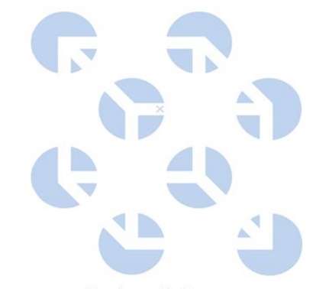
知觉
知觉过程：
自下而上：感官接受外界信号
自上而下：
Take a test
注意： 选择性注意 （非注意盲视）
格式塔理论
知觉填补（filling-in）
受预期、经验、动机等影响
FB Chief Scientist Michael Abrash

Slide 6
知觉的特性
知觉是自适应的：
Prism Glasses Experiment
BrainPort
知觉具有个体差异性：
人和人之间、甚至同一个人不同时间，感官体验不同

Slide 7
知觉重构
‘Most people are totally unconscious of the simple fact that the voice they hear during a cell-phone conversation is not the other person’s voice, but a digital construction that only approximates that voice is measure and produced nearly in real time.’

Slide 8
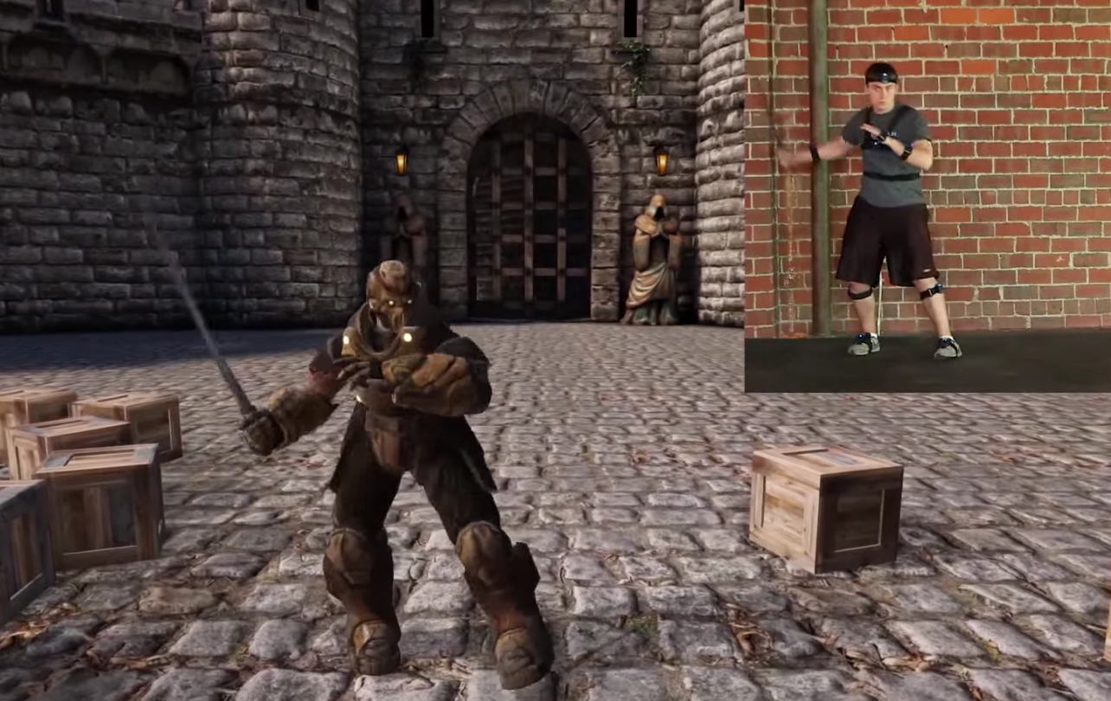
知觉重构的关键
Tracking
Rendering
Display

Slide 9
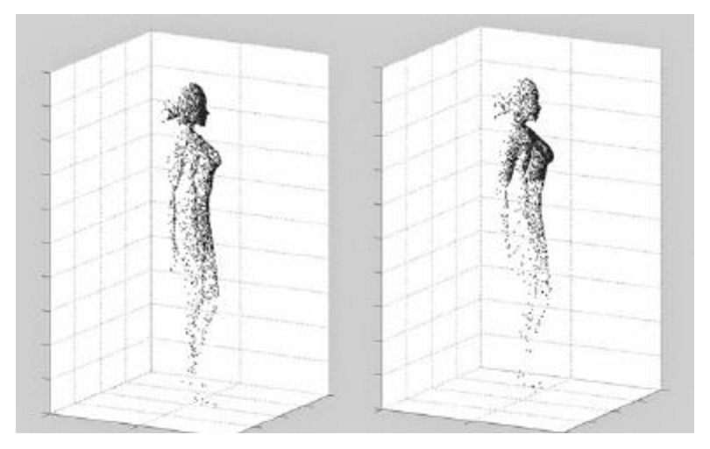

Slide 10
重构现实的基础
VR与现实情境中表现比较：
本能反应：virtual pit
超模照片
社交距离
究竟多真才是真：
运动真实性
人体测量学真实性
图像真实性

Slide 11
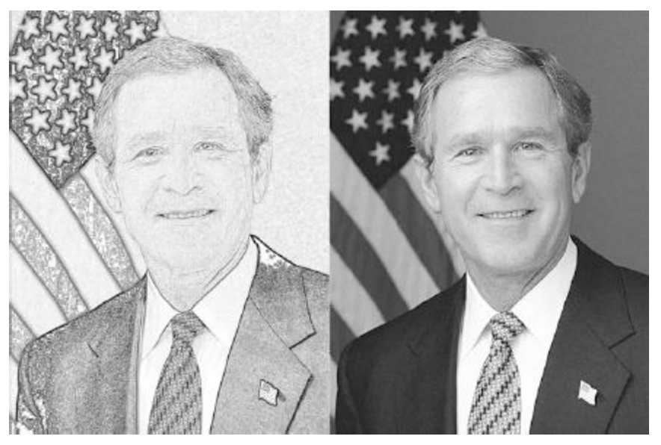

Slide 12
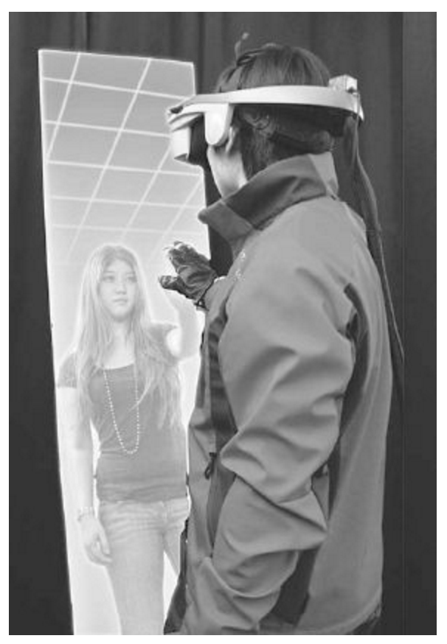
超越现实
虚拟镜子里的自己
上帝的视角看自己

Slide 13
虚拟到现实的转换
’Just as observers see those in black uniforms as tough, and aggressive, so too does the person wearing that uniform.’
将虚拟角色代入现实生活
性别，种族，身高，长相，身材等
对社交和教育的影响 (Avatar vs. Agent):
行为模仿
老师的眼神

Slide 14
哪里是虚拟，哪里是现实
’For humans, reality is, strictly speaking, constructed by minds.’
‘The mind decides if perceptions are real.’
‘Our senses themselves do not say anything. Only our interpretations do, and those are very fallible.’ 《The Beginning of Infinity》

Slide 15
哪个是我，哪个是我的Avatar
‘Is it still my avatar is it looks nothing like me?’
‘If it looks like in me every way but is controlled by a computer algorithm, it is really just an agent?’

Slide 16
人工智能 + 虚拟现实 = 永生？
海量的行为数据：
外貌、言行、动作、表情、手势、人格信息
Psychological Idiosyncrasy
与祖祖父母互动
建立新的关系、对世界有新的理解
我们休息Avatar工作

Slide 17
应用场景
游戏、教育、会议、电影、社交
培训：医疗、体育
军事：America’s Army, Cultural Bootcamp
新闻、摄影：Project Syria
现场转播
治疗：物理、心理（恐惧）
购物、装潢、房地产
旅行
色情产业

Slide 18
科技进步的好与坏
新的生态系统：
新的机会和挑战？
以过去为鉴：
Online vs. Offline
VR会让我们更孤独么？
‘The technology isn’t just physically isolating — in some ways it divides us emotionally, too. ’
我们的后代，那些在VR里长大的孩子会怎么样？
‘One reason the world is fascinated with millennials is that they never knew a world without the Internet. Post-millennials, like my son, will never know life without virtual reality. ’
引发危险行为？

Slide 19
谢谢！

